Slide 1
SUPERMART MANAGEMENT SYSTEM
Efficiently managing your Super mart needs with ease

Slide 2
PROJECT OVERVIEW
The supermarket management system is a relational database handling supermarket data to enable effective communication and teamwork among employees and owners. It comprises tables (e.g., CUSTOMER, PRODUCT, ORDERS) representing various operational aspects, connected through primary and foreign keys for data integrity and advanced queries.

Slide 3
OBJECTIVE
The Objective of our supermarket management system is to create an efficient database that streamlines inventory, sales, customer and employee management, and order processing. The project aims to improve and optimize supermarket operations, and enable better decision-making for management.

Slide 4
APPLICATIONS
The supermarket management system is suitable for small grocery stores, large supermarkets, and hypermarkets. By using this system, businesses can effectively manage inventory, monitor sales and profits, maintain customer and employee data, and process orders and payments. As a result, productivity increases, stock issues are minimized, and valuable insights into customer preferences and sales trends are obtained.

Slide 5
CONTENTS
SR. NO. | TOPIC
1 | ER DIAGRAM
2 | SQL QUERIES
3 | NORMALIZATION
4 | RELATIONAL MODEL
5 | WEB VIEW

Slide 6
1
ER DIAGRAM
ENTITY RELATIONSHIP DIAGRAM

Slide 7
ER DIAGRAM
ENTITY RELATIONSHIP DIAGRAM
CATEGORY_
ID
CATEGORY_NAME
PRODUCT_
NAME
PRODUCT_ID
CATEGORY_
ID
PRODUCT_ID
1
M
PRODUCT
1
1
SALES
CATEGORY
HAVE
HAVE
M
SELLING_
PRICE
COST_PRICE
STOCK
PROFIT
QUANTITY_
SOLD
REQUEST
ORDER_
DATE
1
AMOUNT
CUSTOMER_
ID
ORDERS
ORDER_ID
M
1
PRODUCTS
EMPLOYEE_
ID
TAKE
GIVE

Slide 8
FIRST_NAME
LAST_NAME
GIVE
C_NAME
TAKE
EMP_NAME
C_ID
1
1
EMP_ID
EMPLOYEE
CUSTOMER
C_MOBILE
1
EMP_
GENDER
EMP_
SALARY
EMP_
MOBILE
MAKE
1
AMOUNT
PAY_MODE
PAYMENT
PAY_ID
PAY_DATE
ORDER_ID

Slide 9
2
SQL QUERIES
CREATE TABLE TABLE_NAME ( … ) ;

Slide 10
CUSTOMER
04.
SQL QUERIES
CREATE TABLE TABLE_NAME ( … ) ;
CREATE TABLE CUSTOMER (
C_ID VARCHAR(10) PRIMARY KEY NOT NULL,
C_NAME VARCHAR(40),
C_MOBILE VARCHAR(10),
CONSTRAINT CHECK_PHONE CHECK (C_MOBILE REGEXP '^[0-
9]{10}$’)
);

Slide 11
CATEGORY
CREATE TABLE CATEGORY (
CATEGORY_ID VARCHAR(20) PRIMARY KEY,
CATEGORY_NAME VARCHAR(20)
);

Slide 12
PRODUCT
CREATE TABLE PRODUCT (
PRODUCT_ID VARCHAR(10) PRIMARY KEY,
PRODUCT_NAME VARCHAR(40),
CATEGORY_ID VARCHAR(20),
COST_PRICE DECIMAL(10,2),
SELLING_PRICE DECIMAL(10,2),
STOCK INTEGER,
CONSTRAINT CHECK_STOCK CHECK (STOCK >= 0),
FOREIGN KEY (CATEGORY_ID) REFERENCES
CATEGORY(CATEGORY_ID));

Slide 13
ORDERS
CREATE TABLE ORDERS (
ORDER_ID VARCHAR(10) PRIMARY KEY,
CUSTOMER_ID VARCHAR(10),
AMOUNT DECIMAL(10,2),
ORDER_DATE TIMESTAMP DEFAULT CURRENT_TIMESTAMP,
FOREIGN KEY (CUSTOMER_ID) REFERENCES CUSTOMER(C_ID)
);

Slide 14
ORDER_ITEM
CREATE TABLE ORDER_ITEM (
ORDER_ID VARCHAR(10),
PRODUCT_ID VARCHAR(10),
QUANTITY INTEGER,
FOREIGN KEY (ORDER_ID) REFERENCES ORDERS (ORDER_ID),
FOREIGN KEY (PRODUCT_ID) REFERENCES
PRODUCT(PRODUCT_ID),
PRIMARY KEY (ORDER_ID, PRODUCT_ID)
);

Slide 15
PAYMENT
CREATE TABLE PAYMENT (
PAY_ID VARCHAR(10) PRIMARY KEY,
ORDER_ID VARCHAR(10),
PAY_MODE ENUM('CASH', 'UPI', 'CARD'),
AMOUNT DECIMAL(10,2),
PAY_DATE TIMESTAMP DEFAULT CURRENT_TIMESTAMP,
FOREIGN KEY (ORDER_ID) REFERENCES ORDERS(ORDER_ID)
);

Slide 16
SALES
CREATE TABLE SALES (
PRODUCT_ID VARCHAR(10),
QUANTITY_SOLD INTEGER,
PROFIT DECIMAL(10,2),
FOREIGN KEY (PRODUCT_ID) REFERENCES
PRODUCT(PRODUCT_ID)
);

Slide 17
EMPLOYEE
CREATE TABLE EMPLOYEE (
EMP_ID VARCHAR(10) PRIMARY KEY,
FIRST_NAME VARCHAR(15),
LAST_NAME VARCHAR(15),
EMP_GENDER ENUM('MALE', 'FEMALE'),
EMP_SALARY DECIMAL(10,2)
);

Slide 18
EMPLOYEE_MOBILE
CREATE TABLE EMPLOYEE_MOBILE (
EMP_ID VARCHAR(10),
EMP_MOBILE VARCHAR(10),
PRIMARY KEY (EMP_ID, EMP_MOBILE),
FOREIGN KEY (EMP_ID) REFERENCES EMPLOYEE(EMP_ID)
);

Slide 19
3
NORMALIZATION

Slide 20
1NF
4
NORMALIZATION
A relation R is in first normal form (1NF) if and only if all underlying domains contain atomic values only i.e. does not contain any composite attribute or multi-valued attributes or their combinations.

Slide 21
Reducing Multivalued Attribute
Employee
Employee_Id
Emp_Mobile
Has
Employee
Emp_Mobile

Slide 22
Reducing Multivalued Attribute
Orders
Order_Id
Products
Has
Orders
Order_Items

Slide 23
Reducing Composite Attribute
FIRST_NAME
EMP_NAME
ANIL VERMA
LAST_NAME
FIRST_NAME | LAST_NAME
ANIL | VERMA

Slide 24
2NF
A relation R is in second normal form (2NF)
if and only if it is in 1NF and
every non-primary key attribute is fully dependent on the primary key
In our schema every non-primary key attribute is fully dependent on primary key. Thus it is in 2NF.

Slide 25
3NF
A relation R is in third normal form (3NF)
if and only if it is in 2NF and
every non-key attribute is non-transitively dependent on the primary key
In our schema there is no transitive dependency. Thus it is in 3NF.

Slide 26
4
RELATIONAL MODEL
NORMALIZED

Slide 27
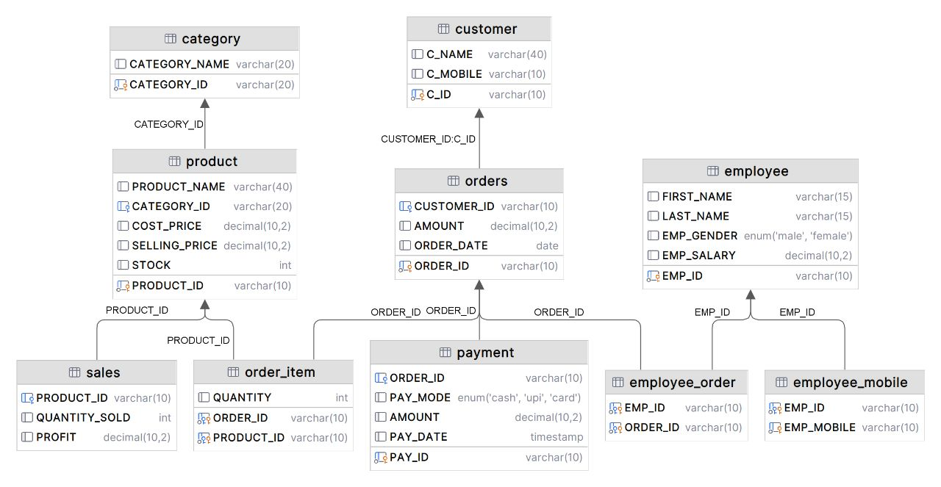
5
RELATIONAL MODEL
ER DIAGRAM -> RELATIONAL MODEL

Slide 28
RELATIONAL SCHEMA
CUSTOMER (C_ID, C_NAME, C_MOBILE)
CATEGORY (CATEGORY_ID, CATEGORY_NAME)
PRODUCT (PRODUCT_ID, PRODUCT_NAME, CATEGORY_ID, COST_PRICE, SELLING_PRICE, STOCK)
ORDERS (ORDER_ID, CUSTOMER_ID, AMOUNT, ORDER_DATE)
ORDER_ITEM (ORDER_ID, PRODUCT_ID, QUANTITY)

Slide 29
RELATIONAL SCHEMA
PAYMENT (PAY_ID, ORDER_ID, PAY_MODE, AMOUNT, PAY_DATE)
SALES (PRODUCT_ID, QUANTITY_SOLD, PROFIT)
EMPLOYEE (EMP_ID, FIRST_NAME, LAST_NAME, EMP_GENDER, EMP_SALARY)
EMPLOYEE_MOBILE (EMP_ID, EMP_MOBILE)

Slide 30
CUSTOMER
C_ID | C_NAME | C_MOBILE
C001 | RAJESH KUMAR | 9876543210
C002 | SONIL GUPTA | 9812345678
C003 | NEHA SHARMA | 9810987645
C004 | AYUSH PATEL | 6587412320

Slide 31
PRODUCT
PRODUCT_ID | PRODUCT_NAME | CATEGORY_ID | COST_ PRICE | SELLING_ PRICE | STOCK
P101 | OATS | C106 | 150 | 200 | 89
P102 | MILK | C103 | 45 | 50 | 157
P103 | KETCHUP | C104 | 90 | 100 | 50
P104 | RICE | C106 | 100 | 125 | 26
P105 | BANANA | C105 | 80 | 85 | 69

Slide 32
ORDERS
ORDER_ID | CUSTOMER _ID | AMOUNT | ORDER_DATE
O001 | C004 | 4500 | 2022-02-23
O002 | C002 | 3200 | 2023-03-15
O003 | C001 | 1200 | 2022-01-08
O004 | C003 | 1200 | 2022-06-11

Slide 33
ORDER_ITEM
ORDER_ID | PRODUCT_ID | QUANTITY
O001 | P101 | 5
O001 | P102 | 3
O002 | P103 | 2

Slide 34
PAYMENT
PAY_ID | ORDER_ID | PAY_MODE | AMOUNT | PAY_DATE
P001 | O001 | UPI | 4500 | 2022-03-14
P002 | O002 | CARD | 3200 | 2022-03-15
P003 | O003 | CASH | 1200 | 2022-03-15

Slide 35
EMPLOYEE
EMP_ID | FIRST_NAME | LAST_NAME | EMP_GENDER | EMP_SALARY
E001 | SURESH | KUMAR | MALE | 30000
E002 | RENU | SINGH | FEMALE | 25000
E003 | ANIL | VERMA | MALE | 28000

Slide 36
EMPLOYEE_MOBILE
EMP_ID | EMP_MOBILE
E001 | 9879654218
E002 | 7845321975
E003 | 6548724387

Slide 37
5
WEB VIEW

Slide 38
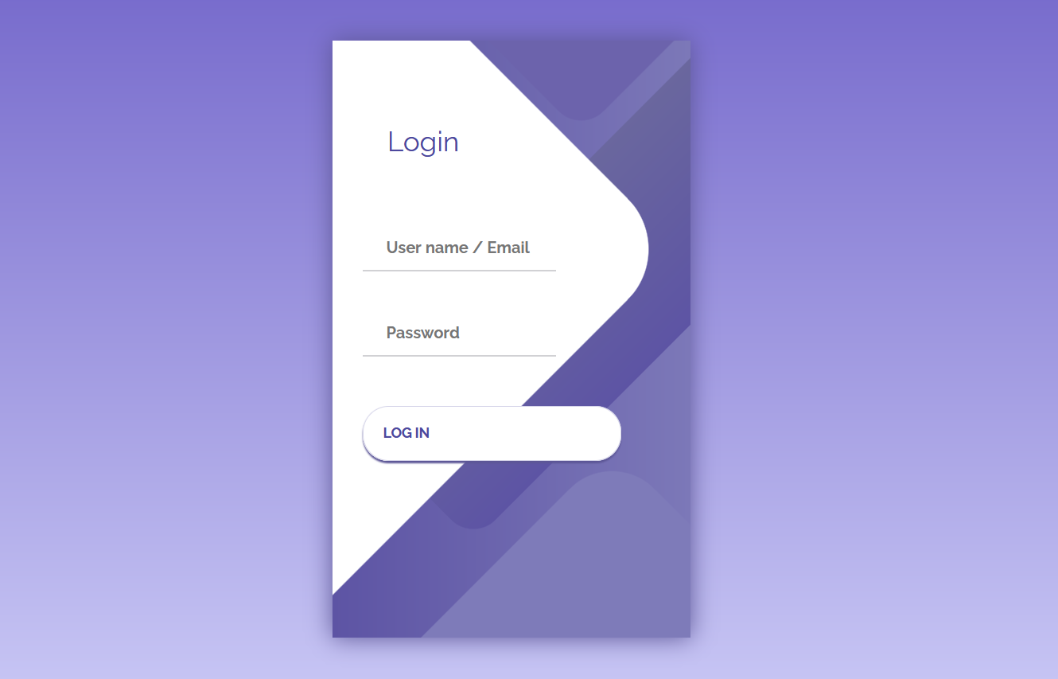
6
RESULTS

Slide 39
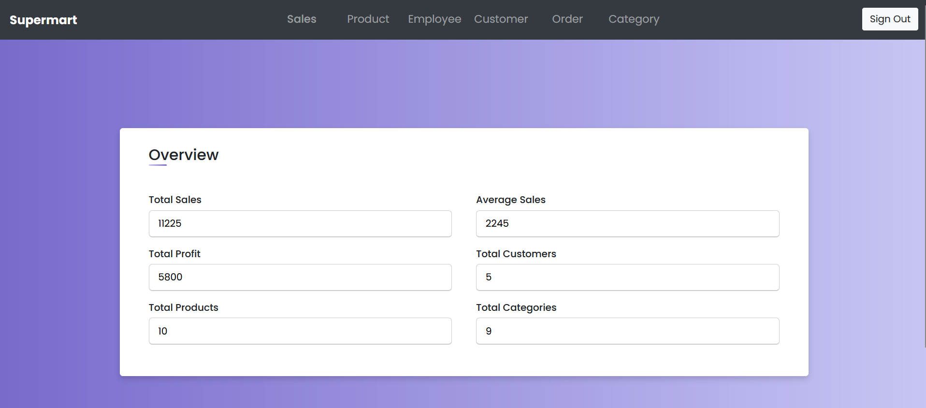

Slide 40
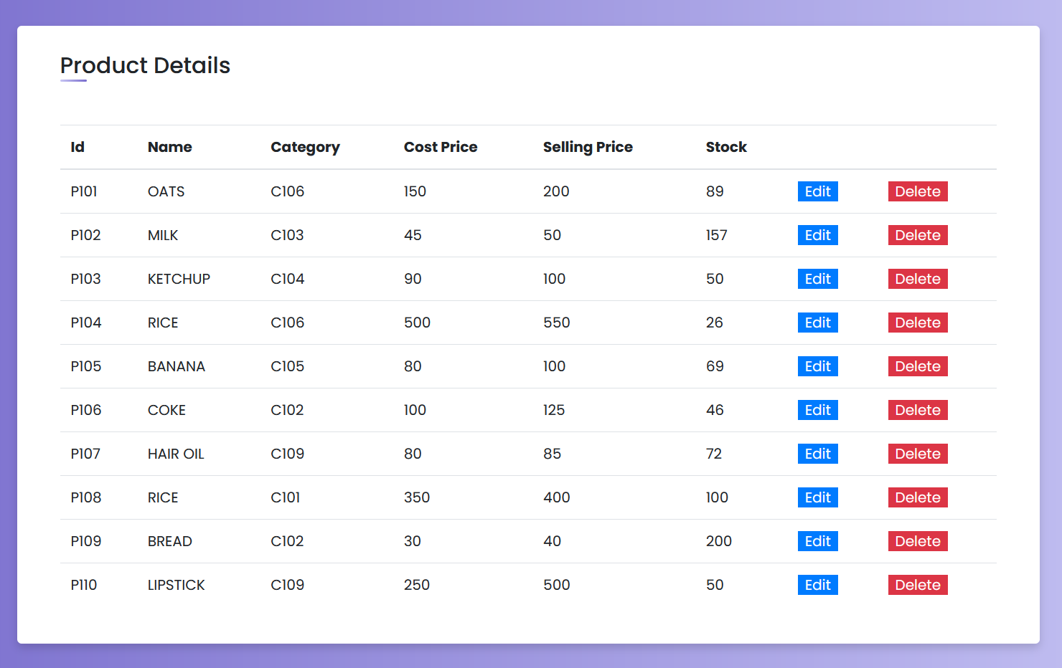

Slide 41
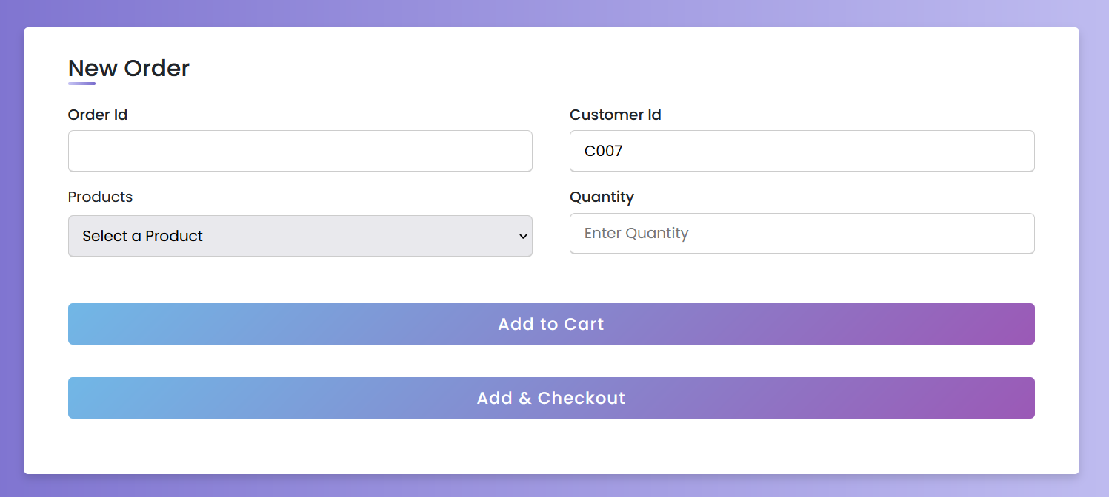

Slide 42
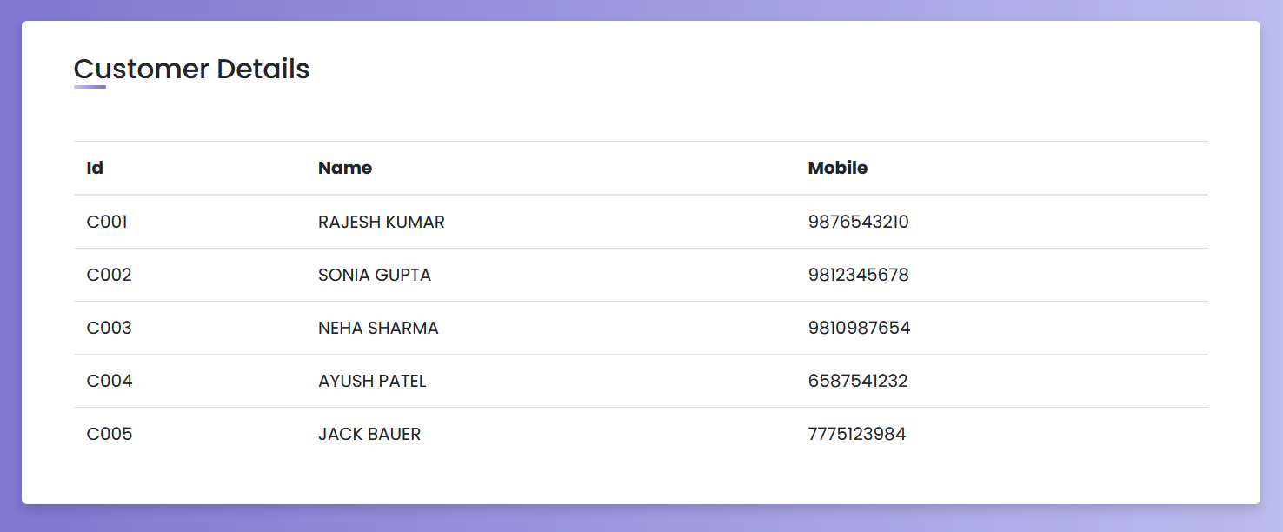

Slide 43
THANK YOU
HARSH SHAH
VRAJ PATEL
TANISH SUTHAR

